Slide 1


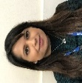



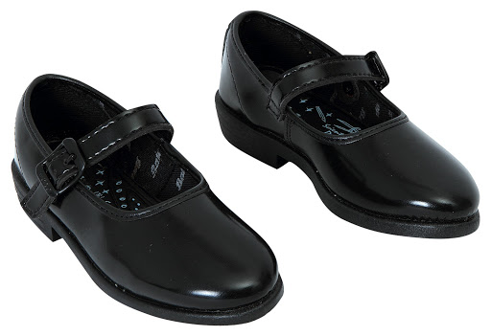



Pear Tree Community Junior School
March 2024
Dear Parents / Carers
We have had another busy half term that has included Parent Consultations, World Book Day, Science Week and lots of trips and different experiences. Once again, we have been impressed with how hard the children have been working and have enjoyed seeing the fantastic work they have been producing.
We hope you have a wonderful Easter Break when it arrives and will see you back at school on Monday 15th April.
Best wishes,
Miss Bounds and Mrs Badwal
Staffing Update
This half term we will be bidding goodbye to Mr Hickey who will be taking on the post of Headteacher at a school in Derbyshire. Although we are sad to lose him, we are excited for him and the next stage of his professional journey. I’m sure you’ll want to join us in wishing him every success and thank him for his hard work and everything he has contributed to our Pear Tree Community.
Mr Hickey’s ‘clap out’ will take place on Thursday 28th March, please join us at 3.15 if you wish to say your goodbyes.
We also look forward to welcoming back our SENCO Mrs Dosanjh from her maternity leave after the Easter Break.
Red Nose Day
Thank you very much for your support in raising an incredible £223.16 for Red Nose Day! Non uniform and donut days are always exciting, much more so if we can help people less fortunate than we are.
Attendance Update
Thank you all for your support in working to improve attendance at Pear Tree Community School. It has been a privilege to work with you all and I have taken so much away from all the interactions I have had with you! I would like to take this opportunity to note that Mrs. Burdis will continue to work tirelessly to help support you in the Summer Term, this includes holding parent forums and refining the attendance initiatives to make sure we get it right. Watch this space for further details.
Uniform
It is important that your child has the correct uniform and PE kit for school.
Our expectations are shown below. Activities may be withdrawn if children are wearing incorrect footwear
Uniform
It is important that your child has the correct uniform and PE kit for school.
Our expectations are shown below.
.Uniform
Look smart: Be the part
Your child is expected to wear uniform everyday
Wearing uniform will give you a sense of belonging and pride
PE Kit
Get fit and wear your kit!
Your child should wear school PE kit on their PE days. This should be blue, white and black!

Slide 2
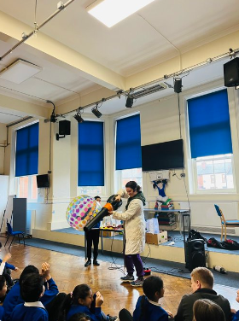
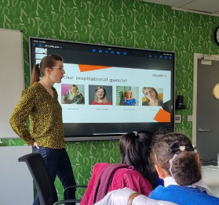
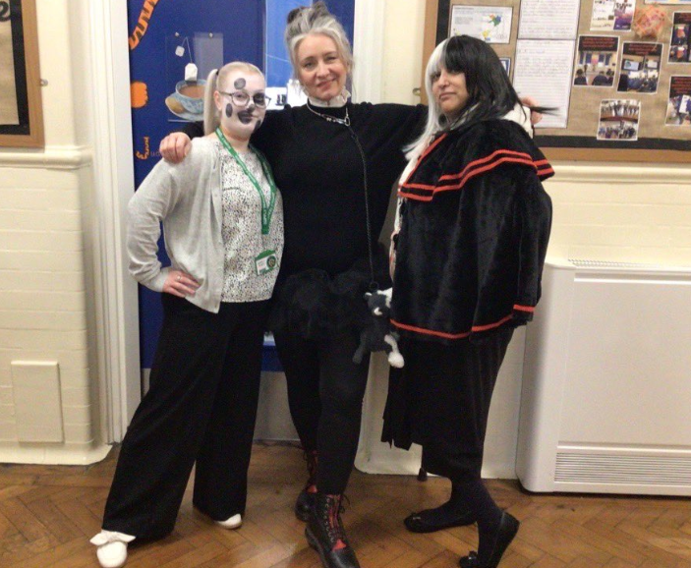
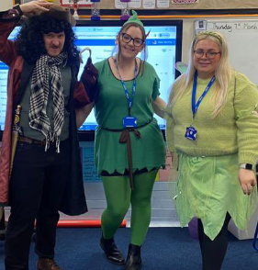
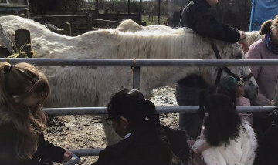



Pear Tree Pride
We have had a fantastic end to the Spring Term. Look below for some of our highlights!
During Science Week, Silly Science
Joined us in school. We also hosted
our own Science Showcase and some our Pear Tree Scientists attended the Trust Science Showcase.
Two of our students attended the
Women in Tech Project at Jigsaw Headquarters. They’ve had a brilliant time!
We had an amazing World Book Day and love completing our World Book Day Hunt!
Year 4 had a great time visiting Meynell Farm!
Dates for this Term
28.03.24 End of Spring Term
15.04.24 Start of Summer Term 1
17.04.24 Vaisakhi Workshop Year 3 & 4
24.04.24 Vaisakhi Workshop Year 5 & 6
26.04.24 Rocksteady Concert
30.04.24 Writing Workshop 2:30pm
06 05.24 Break up for May half term
03.05.24 Start of Summer 2
Dates for the Future
15.04.24 Start of Summer Term 1
06 05.24 Bank Holiday – School Closed
24.05.24 End of Summer Term 1 for pupils
03.06.24 INSET – School closed for pupils
04.06.24 Start of Summer Term 2
19.07.24 Last day of school
22.07.24 INSET – School closed for pupils
23.07.24 INSET – School closed for pupil

