Slide 1


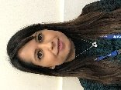

Pear Tree Community Junior School
October 2024
Dear Parents / Carers
It always amazes us how quickly the first half term flies by! The children have continued to try their very best and we always enjoy seeing them come into school with a smile. Next term we have Diwali and Christmas preparations to look forward to, as well as our first parents' meetings of the year – if you haven't booked your appointment yet, please see your child's class teacher. Have a restful half term and we look forward to seeing you back at school on November 4th.
Miss Bounds and Mrs Badwal
TEAtime extra-curricular clubs
We’re excited by the popularity of our TEAtime clubs this year, with over 160 applications for Term 1. However, spaces are limited, and not all children can be accommodated.
To make the process fairer, we are trialling a new system for allocating spaces:
Priority 1: Children who are Looked After or on our SEND register.
Priority 2: Children receiving pupil premium or those new to clubs.
Priority 3: Sibling Groups
Priority 4: Children who have previously attended.
Due to this, your child may receive a place one term but not the next. If this affects your work schedule, please contact Mr. Riley, and we’ll explore how to support you.
Thank you for your understanding.
Nut-Free School
We have a number of pupils in school who have severe allergic reactions to nuts and nut products. To help keep these children safe, we are asking that children do not bring any nuts or nut products into school. This includes:
Peanut Butter and Nutella sandwiches
Some Cereal and Granola bars
Chocolate containing nuts.
Please check ingredients carefully before sending into school.
Chocolate or sweets sent in for a child’s birthday MUST be given to the school office so they can check for nut products and gelatine.
Vacancies
Mid-Day Supervisors and Cleaners
We are currently recruiting for mid-day supervisors and cleaners. Applications can be found here https://www.transformtrust.co.uk/vacancies/ If you would like an informal chat about the roles, please ask to speak to Mrs Ozmen at the school office.
Parent Governors
We are always on the look out for parent governors. If you would like to support the school, please ask for a chat with Miss Bounds or Mr Sharp.

Slide 2


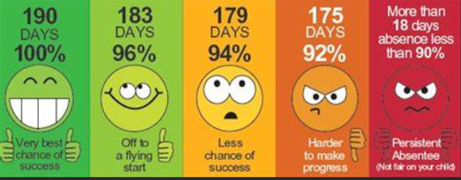







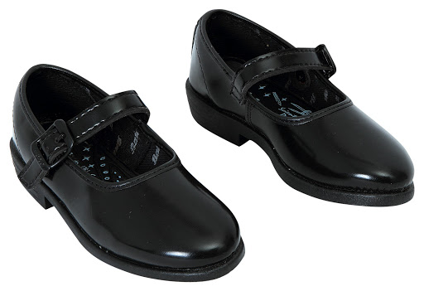


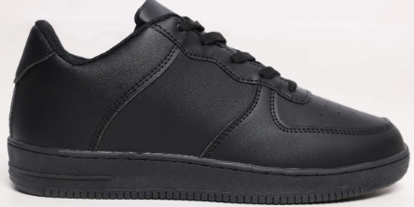
Thank you to all parents who are working with school on children’s attendance. Attendance for each year group has increased from last year.
Year 3 are 95.2%,
Year 6 on 94.5%,
Year 4 on 94.6%
Year 5 on 93.8%.
We are aiming to reach 96% which is the government’s target.
Attendance at Pear Tree Community School
Parents will...... | School will........
1. Value their child's education and value the importance of excellent attendance. | Provide engaging lessons where all children want to attend.
2. Absence Phone school on 01332 760610 if their child is absent by 8:50am and provide any evidence to support the absence e.g. hospital appointment card, doctor’s appointment | Record absences on the register with the correct code.
3. Punctuality Make sure your child is on time. Gates open at 8:45am | 3. Offer breakfast club for children needing to be in school earlier and offer support in an emergency.
4. Leave of Absence Complete a leave of absence form request at least seven days prior to the absence and hand into the office. | 4. Consider a request on an individual basis and inform parents by letter. School will contact Derby City Council.
School and parents will support children to be in school on time, everyday. In the case of no communication, school will phone home or complete a home visit to support the family.
Uniform
It is important that your child has the correct uniform and PE kit for school.
Our expectations are shown below. Activities may be withdrawn if children are wearing incorrect footwear.
Uniform
Look smart: Be the part
Your child is expected to wear uniform everyday
Wearing uniform will give you a sense of belonging and pride
PE Kit
Get fit and wear your kit!
Your child should wear school PE kit on their PE days. This should be blue, white and black!

Slide 3
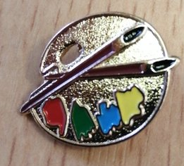
Pear Tree Pride
We are very proud of our community and this page is here to celebrate our success. If you have anything you think should be added to this page, please contact the School Office.
Our Children’s Parliament representatives, Eileen and Omar, have had their first few meetings with other Parliamentarians across Transform Trust. We are looking forward to seeing their projects develop.
This year our Attendance Ambassadors across school are Tesleemah, Jane, Slavomir and Liliana. They will be working with Mrs Burdis and Mrs Elliott to support attendance.
Each year School Council are voted for by their peers to represent their class. The successful candidates will be having their first meeting soon. We look forward to seeing what Abobaker, Helen, Baran, Ziddan, Meivi, Devira, Haneen, Asra, Anmol Ayaan, Keyan and Bella will be up to next!
Our Art Ambassadors have had some exciting sessions with the artist Karen Logan. Well done to Isabell, Joell, Jason, Poppy, Micah, Viraj, Kaeynat, Beritan, Fatima, Aliza, Sophie and Fabian for being selected as Art Ambassadors.
Well done to Derwent who won the school art competition on belonging. Their prize was two sessions with the artist Carla Dee. They had a fantastic time!
Well done to these children for achieving their green Pear Tree badges this term. These children were chosen for a wide variety of reasons but they all show the Pear Tree Superhero Code and Powers every single day. You are all fantastic role models.
Year 3 | Year 4 | Year 5 | Year 6
Magdalena L, Chisimdiri I, Zuzana C | Warisha F, Yaran K, Kirubel K | Haneen M, Omar CM, Yahya N | Nikola K, M. Yousuf KB, Alisha KS
Kaamil B, Saddafe A, Madina A | Jane O, Viraj S, Mahdiya A | Steven D, Abish C, Aamna N | Aleena M, Eileen I, Aliza K
Mahnoor T, Shayan N, David D | Sahasra K, Omid A, M. Mustafa | Oghosa I, Martin K, Krithick L | Yashpreet K, Arwaa B, Lunar W

Slide 4


Upcoming Events
Please see other dates for your diary on the next page of the newsletter. We hope to see you there!
Birthday Parties
This year we have brought back birthday parties. They will take place in the Pakistani Centre every month. If your child had a birthday in September or October, they hopefully enjoyed their birthday party this week.
If your child has a birthday in November or December,
they will receive an invite from school to celebrate.
One adult per child will also be invited to the party.
We look forward to playing party games and
sharing some cake with you!

Slide 5


Diary Dates
 | Start | End | Inset days
Autumn 1 | 05.09.24 | 25.10.24 | 04.09.24 04.10.24
Half term: 26.10.24-01.11.24
Autumn 2 | 04.11.24 | 20.12.24 | none
Christmas: 23.12.24-03.01.25
Spring 1 | 06.01.25 | 14.02.25 | none
Half Term: 17.02.25-21.02.25
Spring 2 | 25.02.25 | 04.04.25 | 24.02.25
Easter: 07.04.25-21.04.25
Summer 1 | 22.04.25 | 23.05.25 | none
Half Term: 26.05.25-30.5.25
Summer 2 | 03.06.25 | 24.07.25 | 02.06.25 20.06.25
A reminder that holidays should be booked during holidays periods (dates in yellow boxes). Any holidays taken in term time will be unauthorised and may result in a fine.
Autumn 2 Dates and Events
04.11.24 | Return to school for Autumn 2
05.11.24 | Year 6 Pupil Progress Meetings
06.11.24 | Year 4 Pupil Progress Meetings
07.11.24 | Diwali events
11.11.24 | Anti-Bullying Week
12.11.24 | Year 3 Pupil Progress Meetings
13.11.24 | Year 5 Pupil Progress Meetings
19.11.24 | November birthday party
Autumn 2 Dates and Events
10.12.24 | December birthday party
18.12.24 | Year 3 Nativity Performance
19.12.24 20.12.24 | Recognition Assemblies (times and year groups tbc)
20.12.24 | Last Day of Autumn 2
06.01.25 | Return to school for Spring 1

Slide 6



