Slide 1
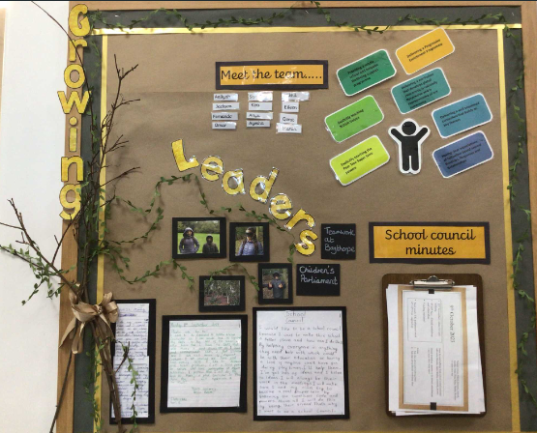

Pupil leadership at Pear Tree
Children’s Parliament –team building
Minutes of the meeting –school council
Letters of application for School council

Slide 2
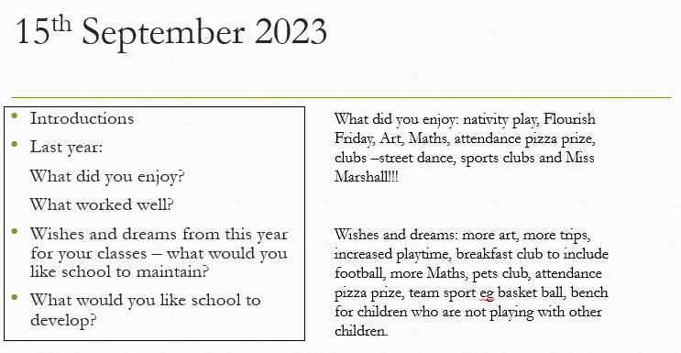
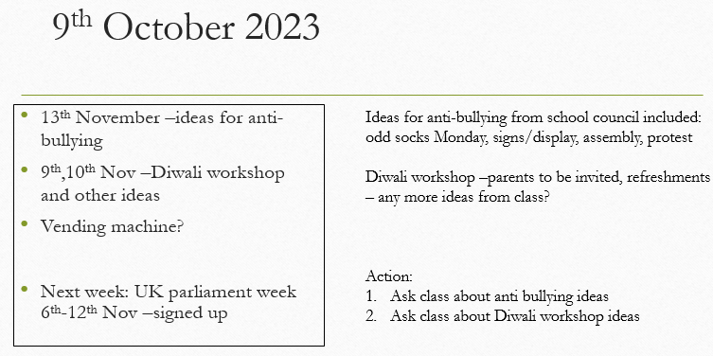
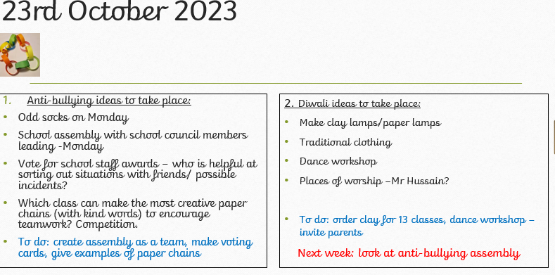
Autumn 1
Discussions Impact
Baseline and reflections from last year
Anti bullying workshop booked as a result of class suggestions and wearing odd socks – raise awareness
School council performed an assembly to the whole school showing impact of workshops and to consolidate understanding of children
Diwali workshops booked as a celebration of Diwali –this was chosen by classes –parents were invited 53 parents came

Slide 3
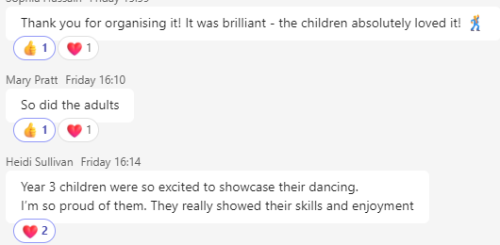
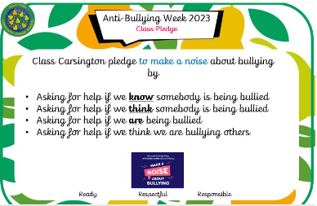
Autumn 2
School council engaged all classes with ideas for Diwali – classes chose a Diwali dance workshop.
School council assembly for anti bullying week
Class pledge/poster

Slide 4
Next steps:
Linking children’s parliament to School Council
Children’s Parliament to be leading on Eco-questionnaire and children’s Charter and to engage school council
Children’s Parliament are interesting in developing the school grounds and have engaged a teacher who is leading on forest schools – they are interested in encouraging more wildlife into the school grounds and have met with the teacher to decide what this could look like eg bug hotels, bird boxes –school council will feed into this process

